Slide 1
Valley Metro
Team 1:
Sabrina Avila, Cristina Ceniceros, Scott oathout, Philip Wewiora

Slide 2
Valley Metro Bus and Rail Ridership Questions?
Is public transportation keeping up with the growing Phoenix population?
How does income and poverty effect public transportation usage?
How has Covid-19 impacted rail ridership?

Slide 3
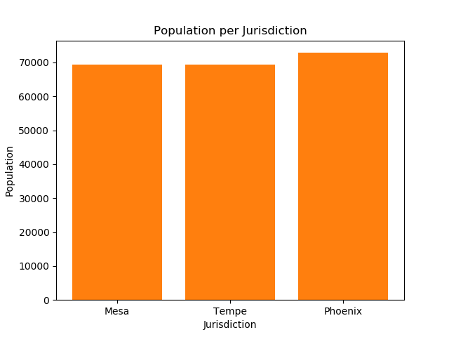
Census API Pull Data Issues

Slide 4
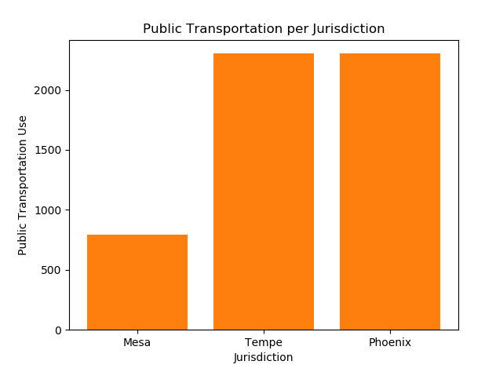
Census API Pull Data Issues

Slide 5
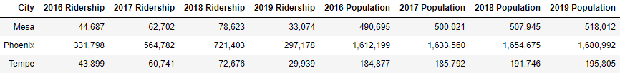
Population vs Valley Metro Bus Ridership (2016 – 2019)
*2016 Data Only Includes April Through December
*2019 Data Only Includes January Through June

Slide 6
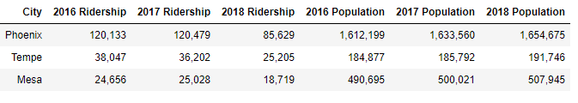
Population vs Valley Metro Rail Ridership (2016 – 2018)
*2018 Data Only Includes January Through September

Slide 7
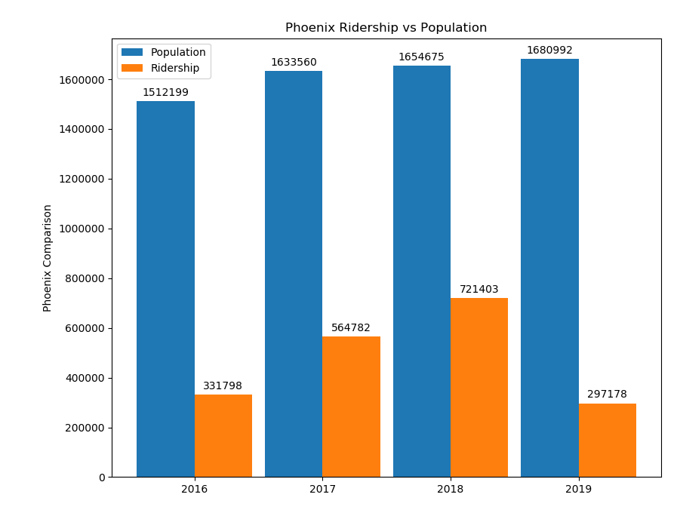
Phoenix Jurisdiction Bus Ridership with Population Growth
Ridership vs Population
2017 : 34%
2018 : 44%

Slide 8
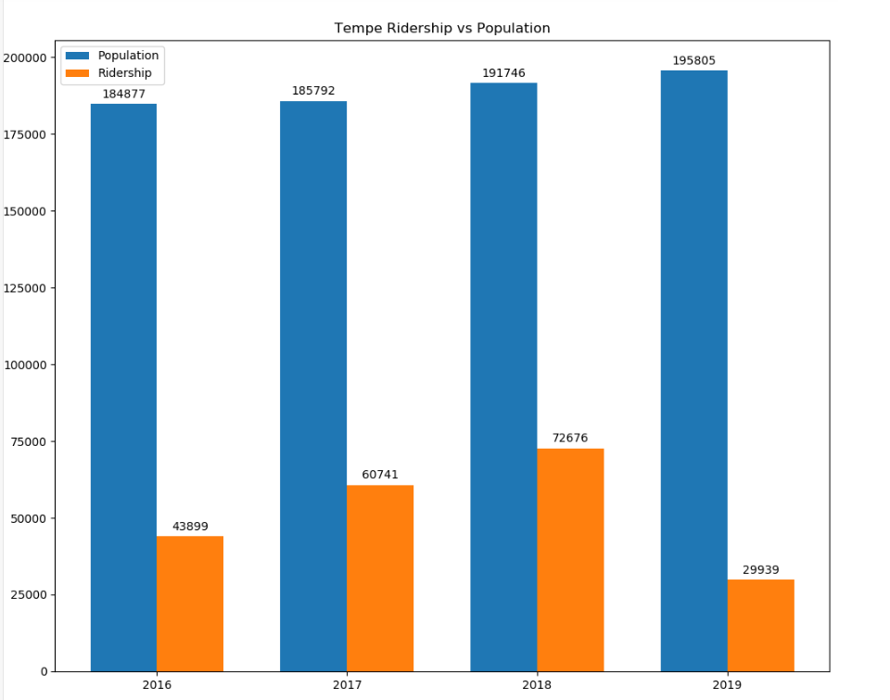
Tempe Jurisdiction Bus Ridership with Population Growth
Ridership vs Population
2017 : 33%
2018 : 38%

Slide 9
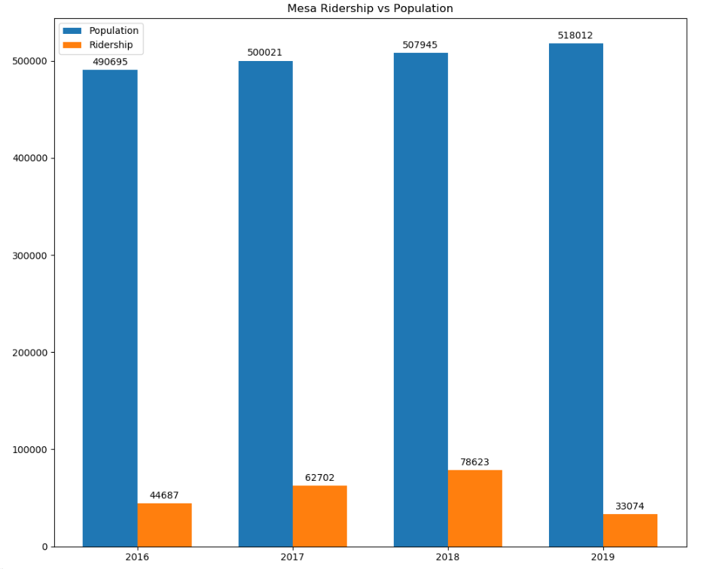
Mesa Jurisdiction Bus Ridership with Population Growth
Ridership vs Population
2017 : 13%
2018 : 15%

Slide 10
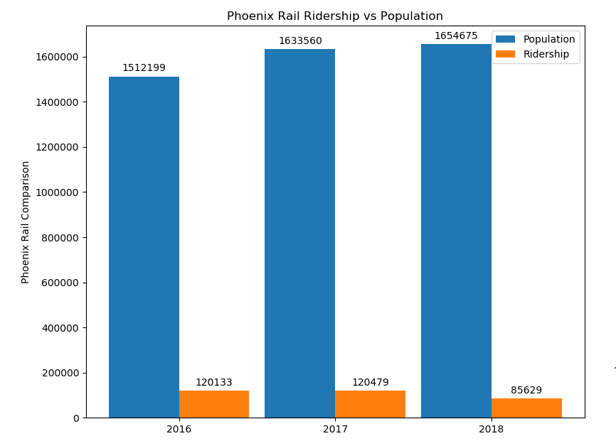
Phoenix Jurisdiction Rail Ridership with Population Growth
Ridership vs Population
2016 : 8%
2017 : 7%

Slide 11
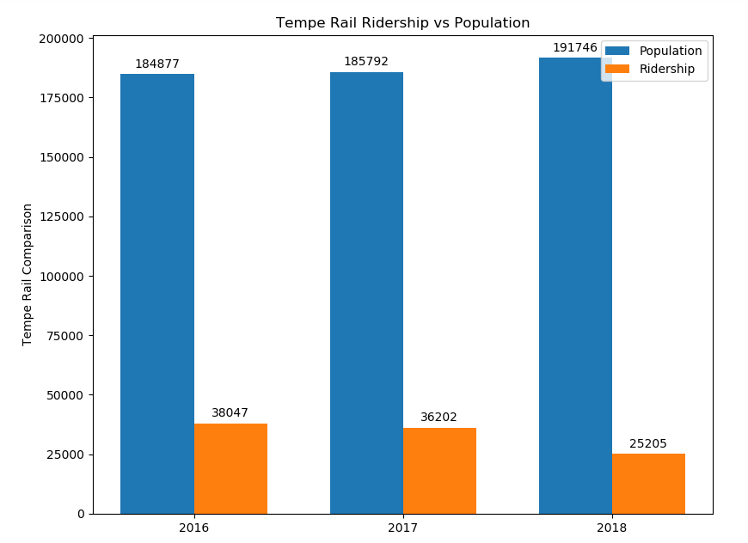
Tempe Jurisdiction Rail Ridership with Population Growth
Ridership vs Population
2016 : 21%
2017 : 19%

Slide 12
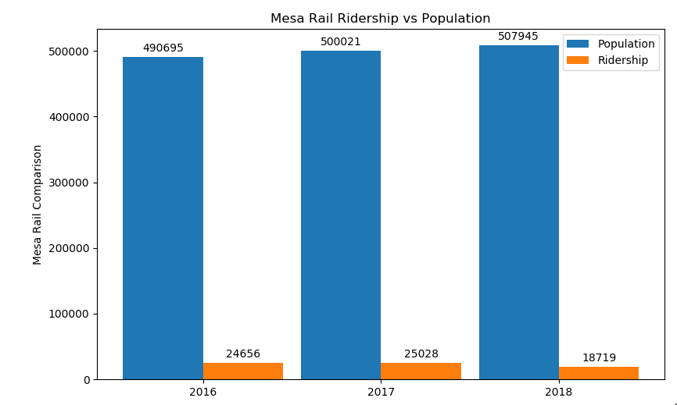
Mesa Jurisdiction Rail Ridership with Population Growth
Ridership vs Population
2016 : 5%
2017 : 5%

Slide 13
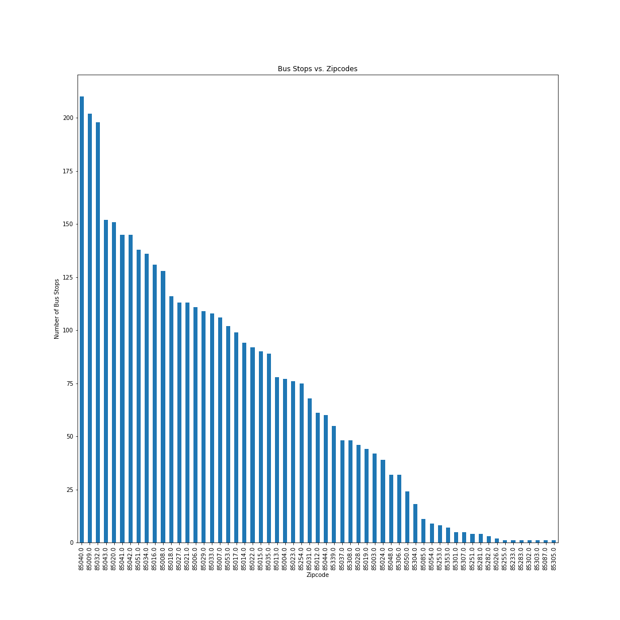
Bus Stops vs Zip Codes
QUESTION
Do low income areas rely more heavily on public transportation?
THE DATA
58 Zip Codes
Highest number of bus stops from one zip code is 210
Seven zip codes only one bus stop

Slide 14
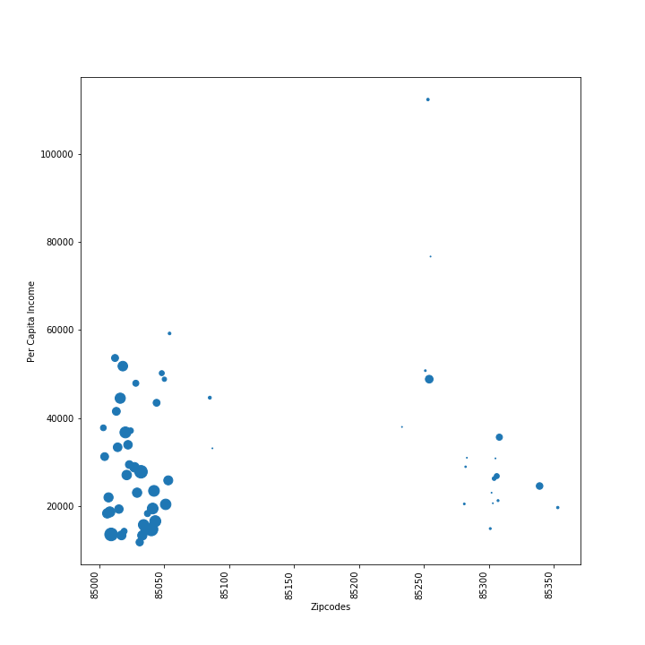
Zip Code vs Income (size = poverty rate)
EXPECTATIONS
Zip codes with higher poverty rate will have a higher number of bus stops
Wealthier zip codes will have fewer bus stops

Slide 15
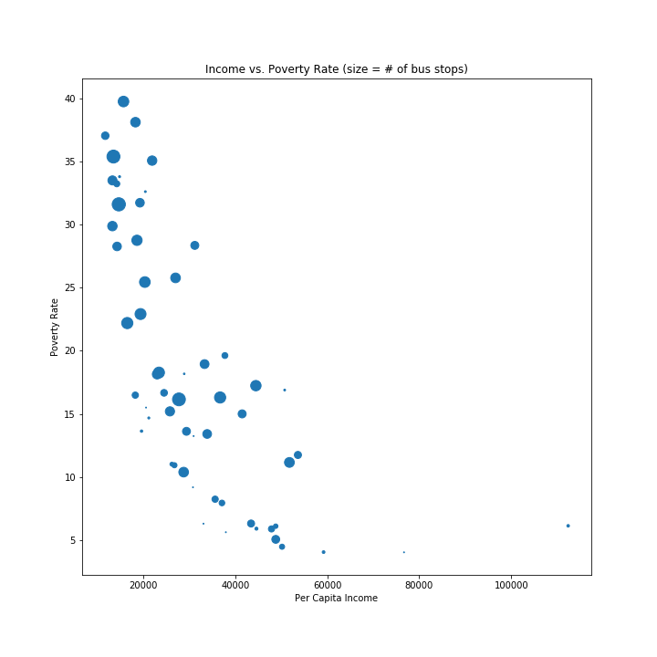
Income vs Poverty Rate (size =+ of bus stops)
ANALYSIS
Lower income zip codes have a higher number of bus stop locations
Wealthier zip codes lack access to public transportation

Slide 16
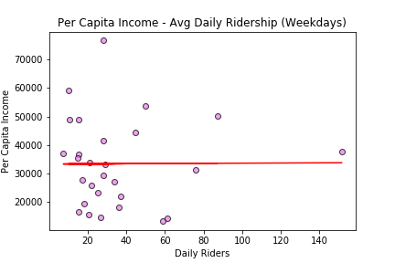
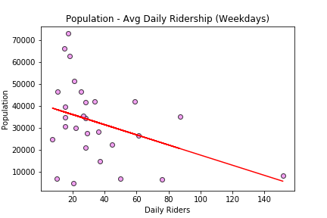
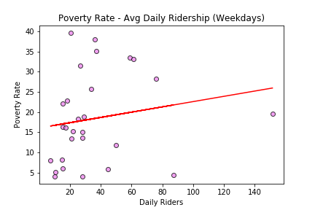
r-squared: 3.4311155928445093e-05
r-squared: 0.1488667616559437
r-squared: 0.031234691587659163

Slide 17
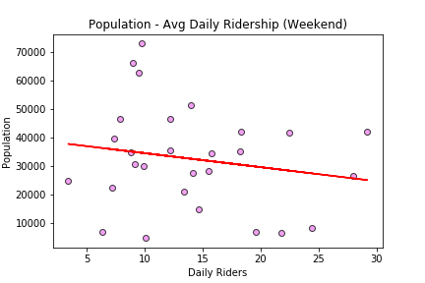
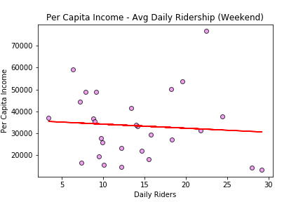
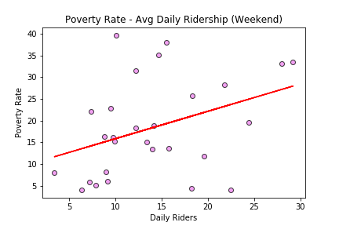
r-squared: 0.03272683488048145
r-squared: 0.006334681562971795
r-squared is: 0.1412828524696236

Slide 18
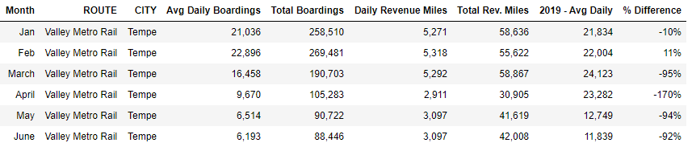
COVID Impact

Slide 19
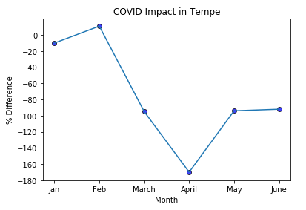
COVID Impact

Slide 20
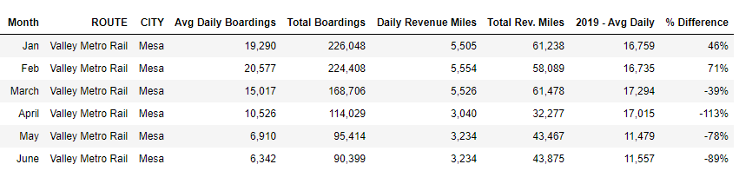
COVID Impact

Slide 21
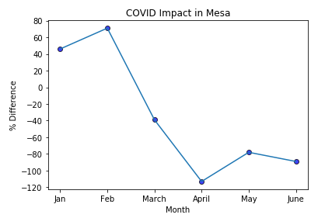
COVID Impact

Slide 22

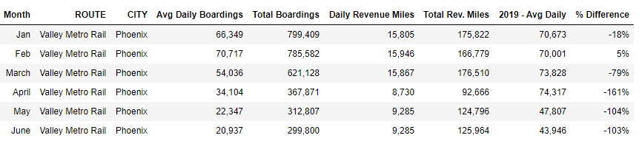
COVID Impact

Slide 23
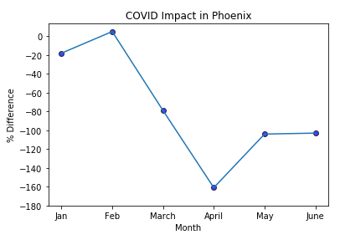
COVID Impact

